Slide 1
METRIC BASED TRANSFER LEARNING APPROACH FOR FACIAL RECOGNITION SYSTEM BATCH – 7
TEAM:
Sai Kowshik Ananthula
Sahithi Kolla

Slide 2
Abstract
Face recognition system collects distinct features of the face and converts them into mathematical data, and then it compares with existing trained data in a vast database. When the data is significantly less, the process of learning good features for machine learning becomes computationally expensive and difficult.
We have tried to incorporate a facial recognition system that uses a one-shot metric approach to generalize unrecognized categories without large datasets. Unlike other commonly used neural network architectures, which only learn to classify input using the classification loss functions, then the model learns to differentiate between the two inputs.
In this work, We use Siamese architecture, a one-shot learning algorithm, i.e. it can learn to recognize any face using just a single training sample.

Slide 3
Contents
Introduction
Problem Definition
Methodology
Implementation
Results
Conclusion
References

Slide 4
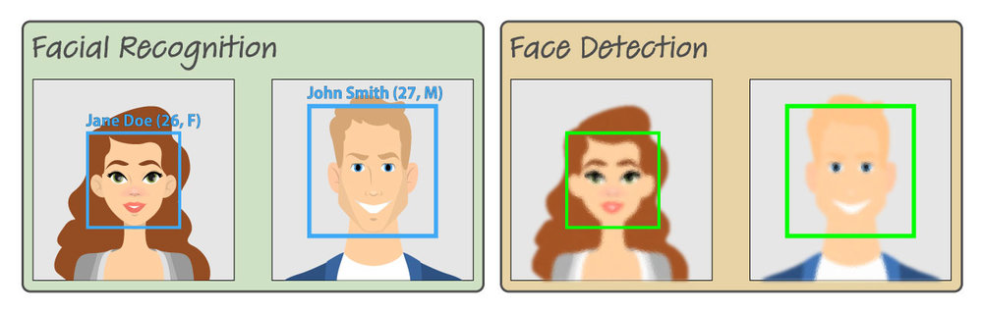
Introduction
Face detection just means that a system is able to identify that there is a human face present in an image or video. Face detection has several applications, only one of which is facial recognition. Face detection can also be used to auto focus cameras. And it can be used to count how many people have entered a particular area.

Slide 5
ONE-SHOT LEARNING APPROACH
Normally, in deep learning, a large amount of data is required, and the more data we have, the better the results become.
However, because not all of us have access to a large amount of data, it will be more convenient to learn from a small set of data. Furthermore, the brain does not require thousands of images of the same object in order to recognize it.
The idea here is that we need to learn an object class from a small amount of data, which is what the One-shot learning algorithm is.

Slide 6
Drawbacks of Existing Deep Learning Architectures
Other existing machine learning and deep learning models learn to classify inputs primarily through the use of classification loss functions. The Siamese Neural Network architecture, as a metric-based one-shot learning method, is computationally cheap.
Unlike the other algorithms, this architecture uses a supervised metric-based approach to learn image embeddings, and the same network's characteristics are reused for one-shot learning excluding fine-tuning

Slide 7
Problem Statement
Many machine learning algorithms and architectures necessitate a large amount of data and training.
This necessitates a significant amount of data collection, computational complexity, training, and fine tuning.
There may be a few instances where a large amount of data is unavailable, or other factors that may impede the approach to designing and implementing a face recognition system.

Slide 8
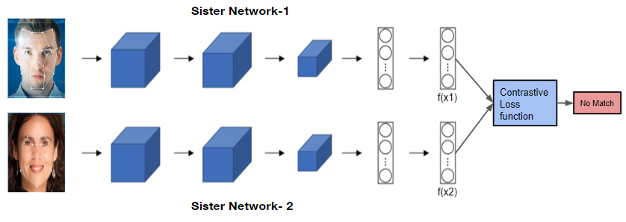
Siamese Network

Slide 9
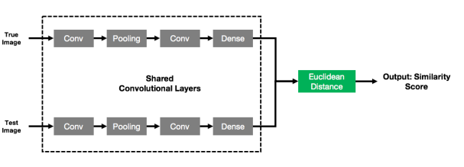
Methodology

Slide 10
Mathematical Approach
Step 1:
Here we use a 2-dimensional convolution. It can be mathematically represented as:
[f * g] (x) = ∫ f(t) . g(t − x) dt
The input image is represented by function f, and the kernel function is represented by function g.

Slide 11
The discrete convolutional mathematical expression for a 2-dimensional convolution can be represented as: -
[f * g] (x) = ∑ f(t) . g(t − x)
The kernel function (matrix K, i.e., function g) slides over the input (matrix I, i.e., function f) and produces the feature map output (matrix O).
The feature map has the same dimensions as the kernel function.
The degree to which the functions f and g overlap as one passes over the other is referred to as the feature map. The feature map searches the input for the same pattern in different locations.

Slide 12
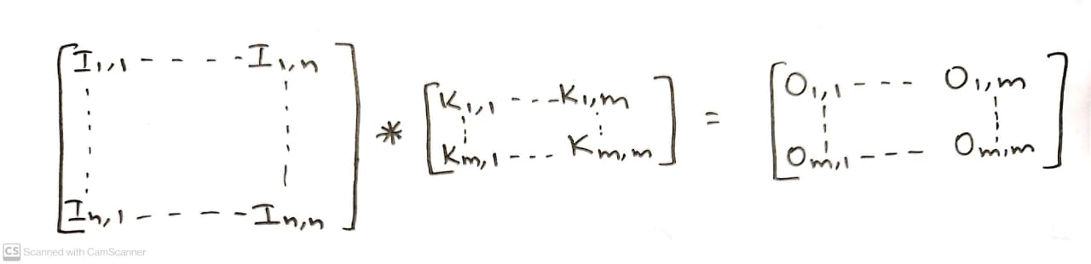
The preceding operation can be represented as follows:
[I x K] (i,j) = Σm [Σn ( I(m,n) . K (i-m, j-n))]
Step 2
This output is now being routed to the pooling layer.
It shrinks the size of the feature map by dragging a window across it and outputs the maximum value.

Slide 13
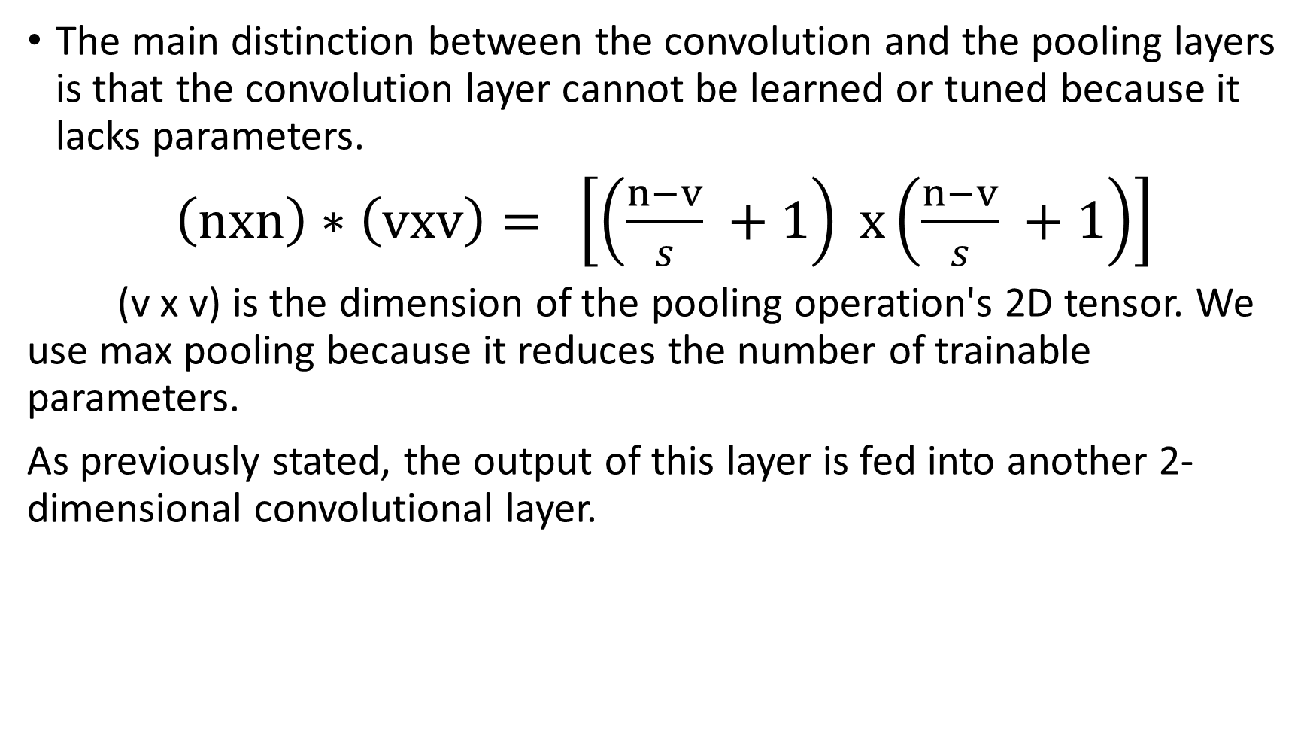

Slide 14
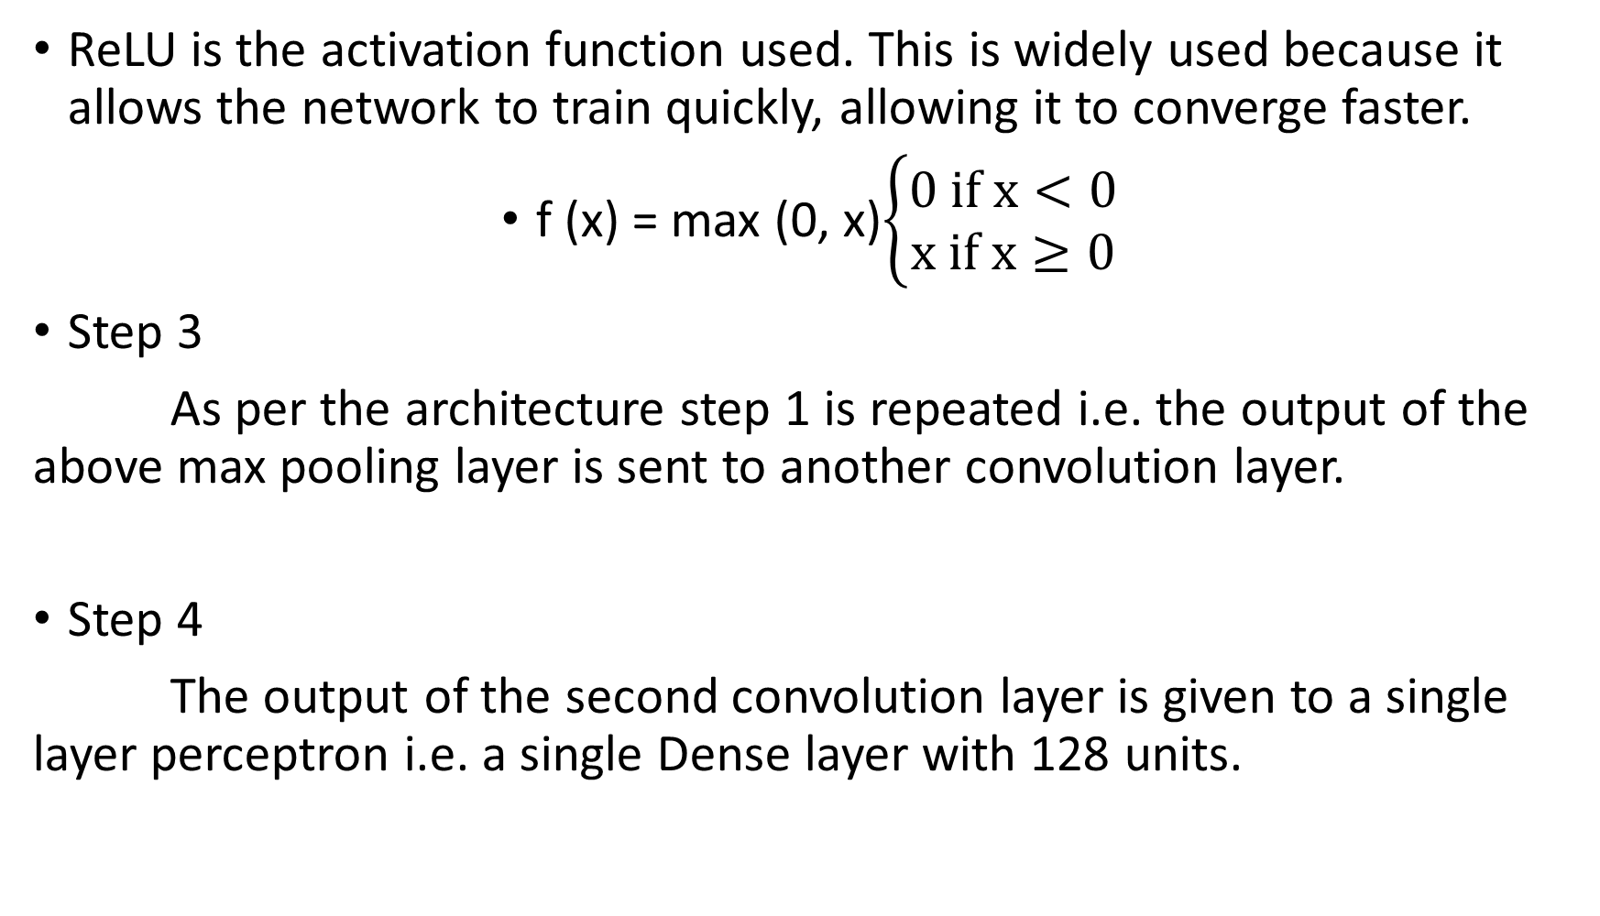

Slide 15
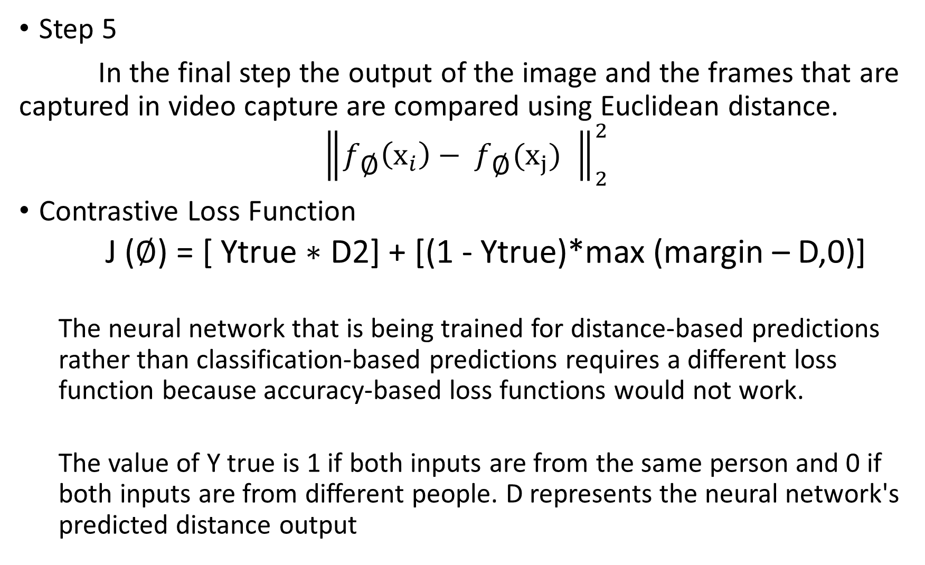

Slide 16
Cascading
Stage 1
Is it a face?
Stage 2
Is it a face?
i/p
maybe
maybe
No!
No!
Discard i/p Discard i/p
Advantage- It can reject any input in very less time if it does not match with the features

Slide 17

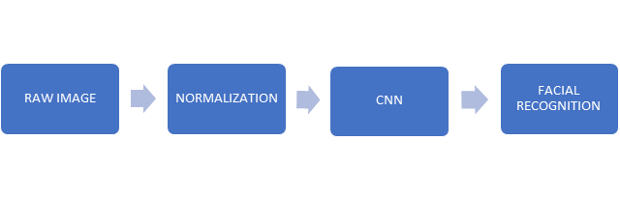
Implementation

Slide 18
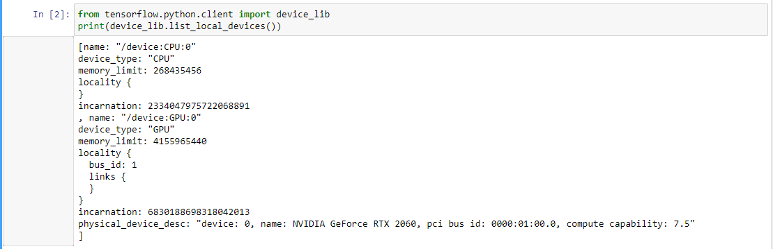
Using Tensorflow_GPU
Using TF_gpu helps in faster training of 26615936 parameters within 1 minute for 15 epochs

Slide 19
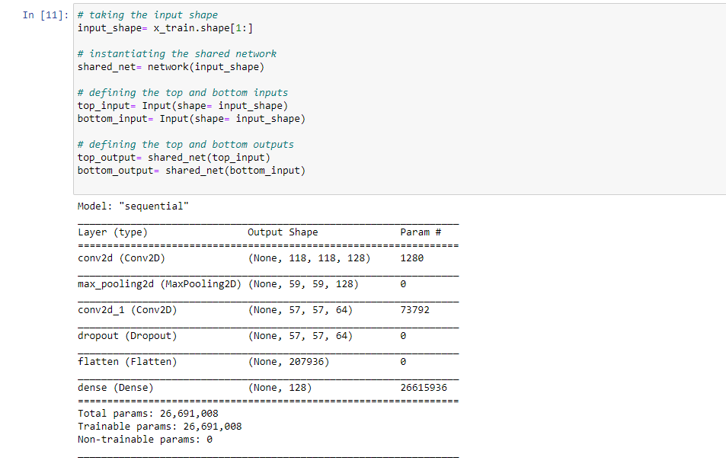
Total Parameters and Layers

Slide 20
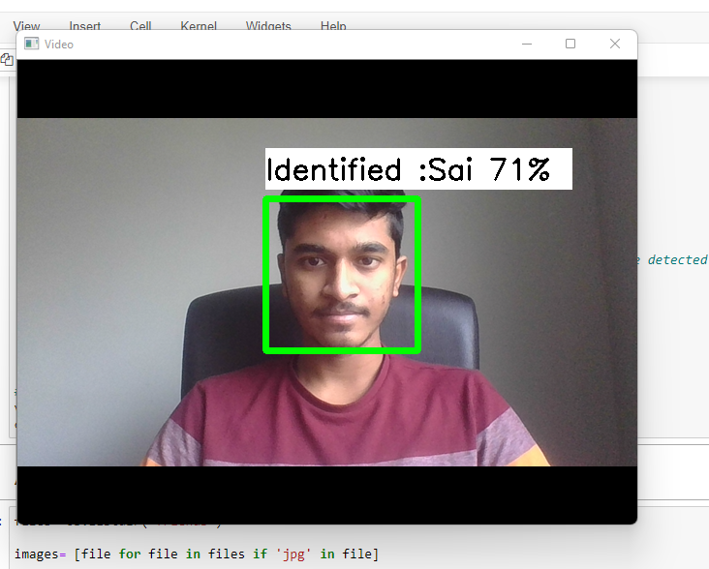
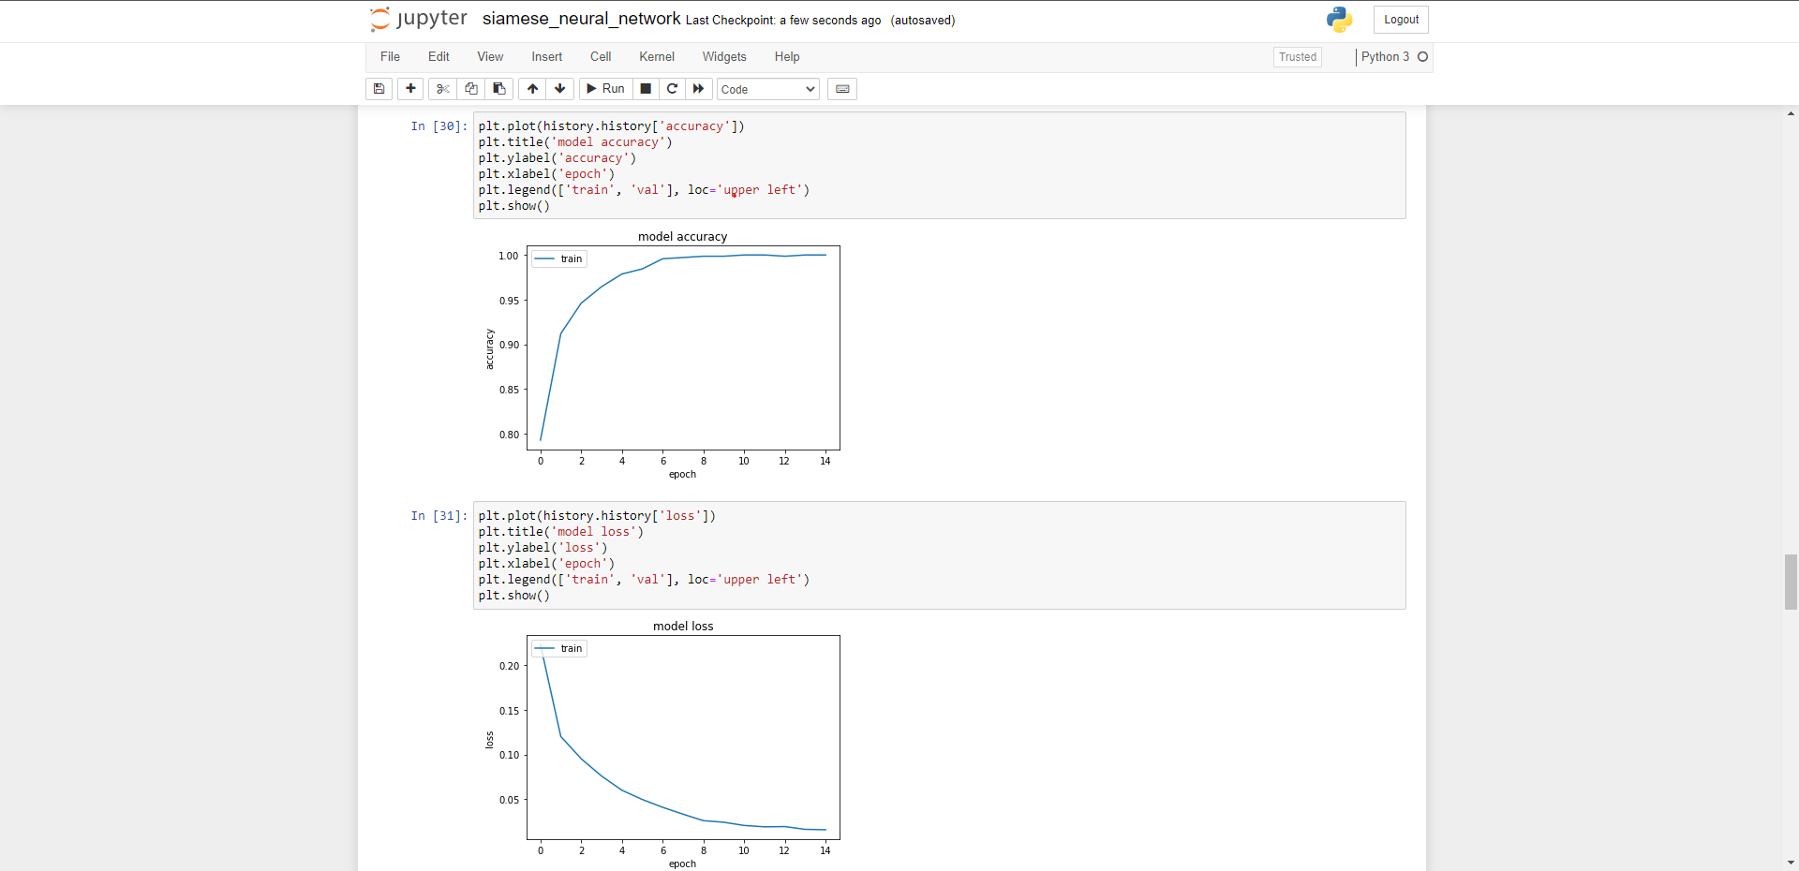
Results
ACCURACY
DETECTION

Slide 21
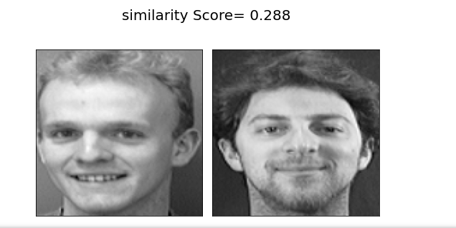
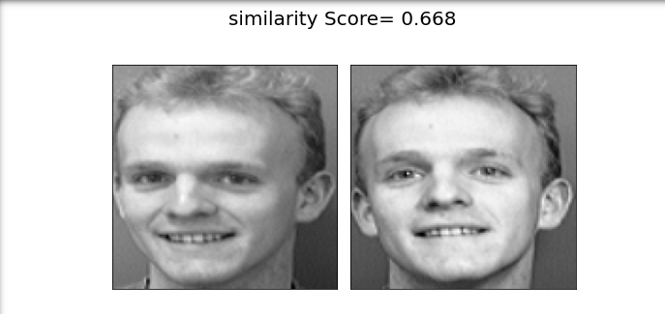
FALSE NEGATIVE
TRUE POSITIVE

Slide 22
Conclusion
In conclusion, our study uses sophisticated techniques such as contrast adaptation, bi-lateral filters, and histogram equalisation for the pre-processing of images inputs.
This method is replicated to create the binary pattern for each pixel in all other regions to construct the input face vector.
System that can be applied in a world of real life.

Slide 23
References
Serign Modou Bah, Fang Ming School of Computer Science and Technology, Changchun University of Science and Technology, Changchun, China
Human face detection algorithm via Haar cascade classifier
Face Recognition Using Haar Cascade Classifier
A Study about Principle Component Analysis and Eigenface for Facial Extraction
Face Recognition Using Principal Component Analysis Method

Slide 24
THANK YOU Questions?

